Slide 1
English in Singapore,
Singapore(an) English(es)
Université de La Réunion
4 November 2026
Notes:
60 minutes + questions

Slide 2
Outline
Background
Location
History
Diversity
Current changes
Attitudinal changes
Linguistic changes
Singapore(an) English(es)
Standard
Singlish
English in Singapore
Policies
Shift

Slide 3
Background

Slide 4
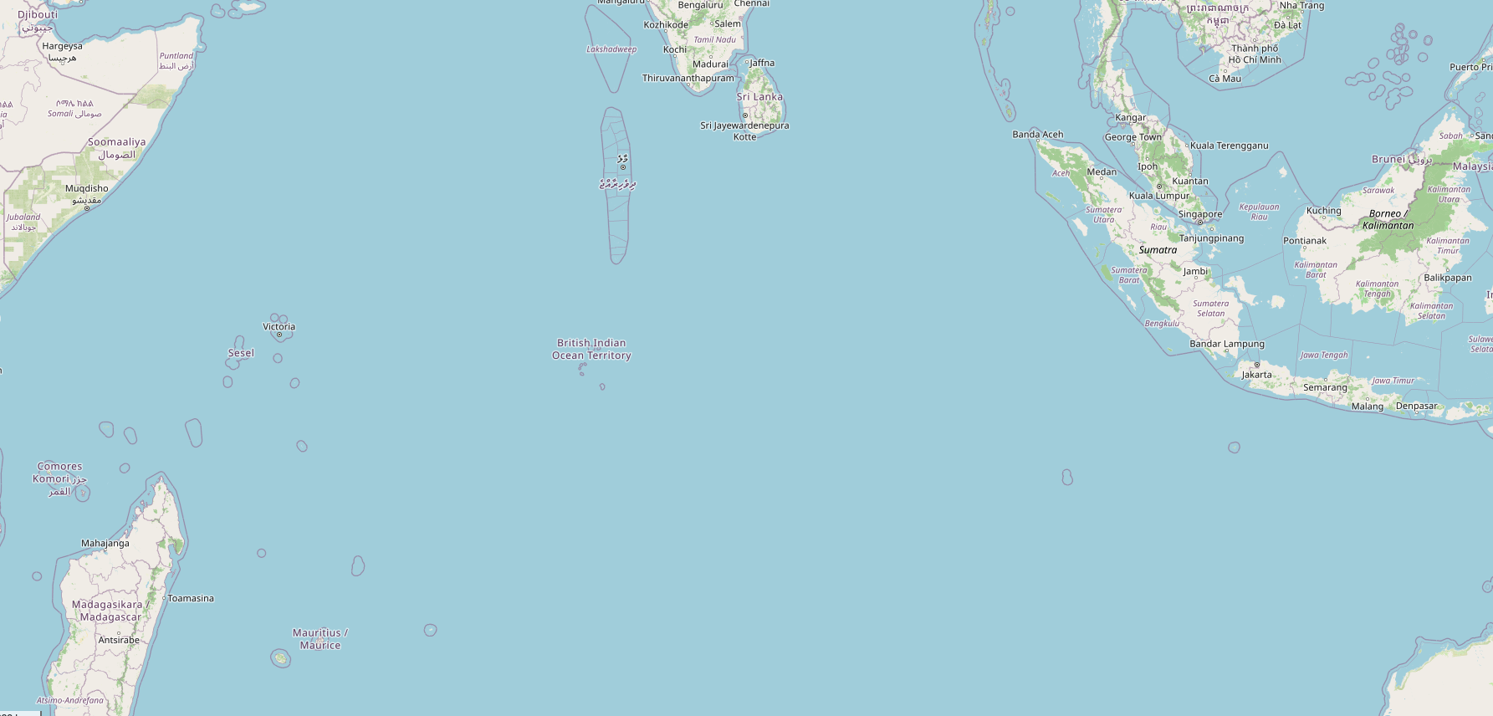
Location
Notes:
Almost 6,000 km

Slide 5
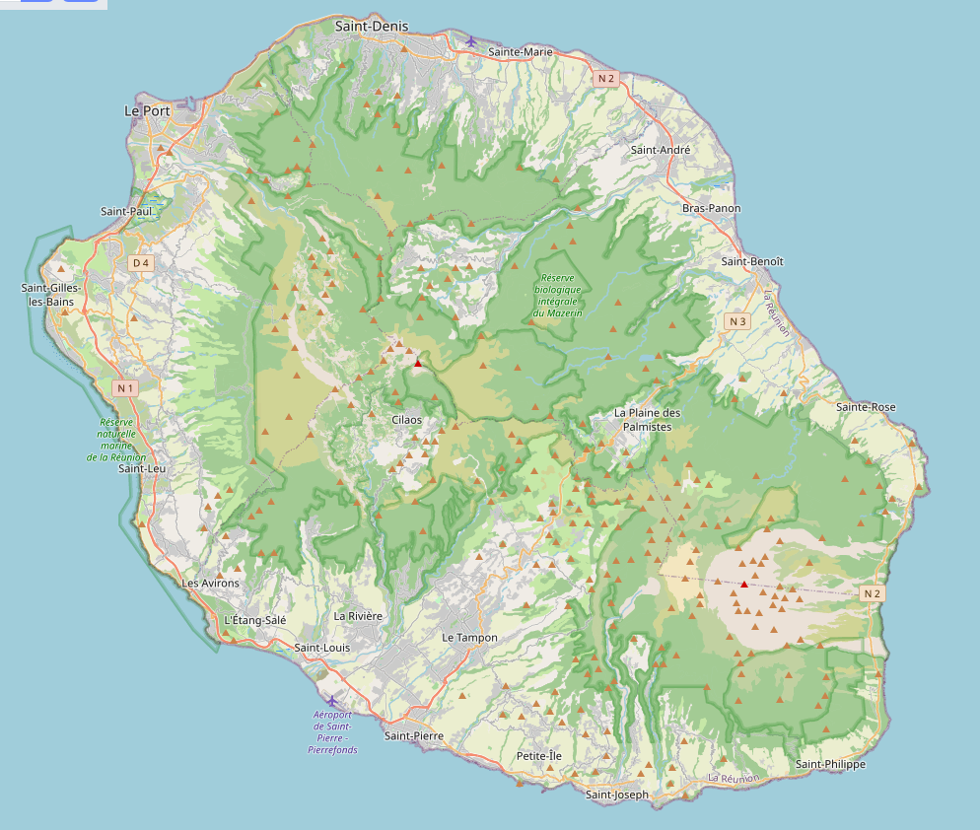
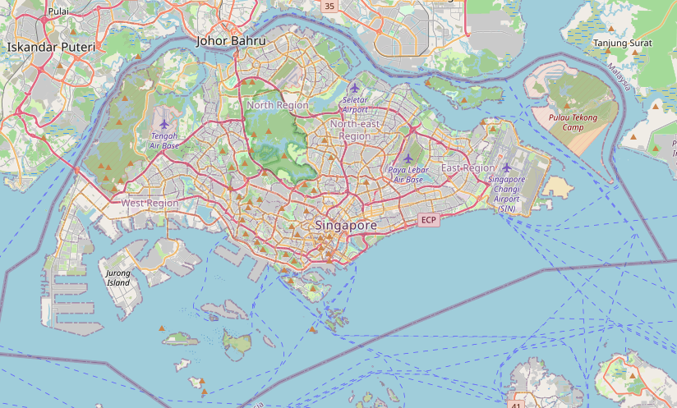
Location
Réunion Singapore
21° S 1.2° N
2,511 km² 744 km²
Pop. 911,000 6,110,200
Notes:
About a third of the size of Réunion

Slide 6
Location
http://www.gis-reseau-asie.org/uploaded_files/images/monthly-articles/article-100101/edito_100101_2_routes_maritimes_en_gm.jpg
Notes:
Note: not in China!

Slide 7
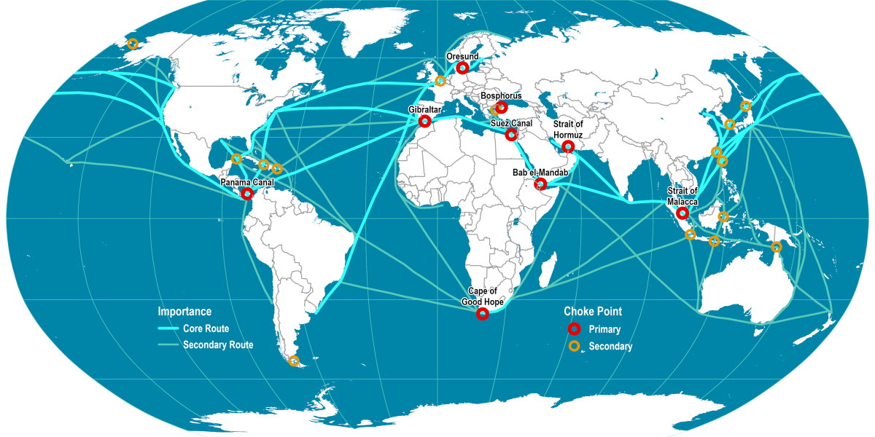
Location
https://hakaimagazine.com/wp-content/uploads/map-igd-maritime-choke-points-1200x600.png
Notes:
Strait of Malacca: 25% of the world’s traded goods
Busiest port outside of China

Slide 8
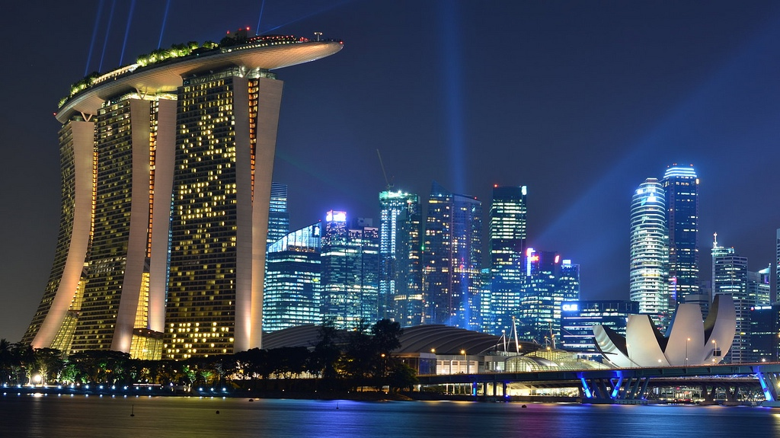
History

Slide 9
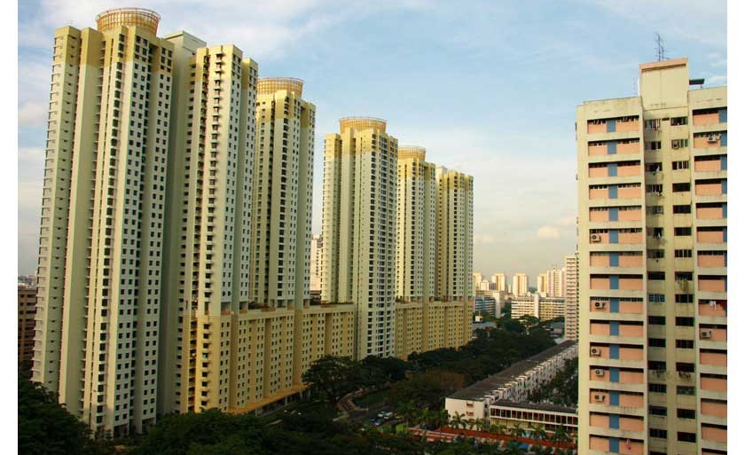
History

Slide 10
History
Pre-colonial times
1819: British landing party
1824: Anglo-Dutch Treaty
1867: Crown Colony
1942–1945: Japanese occupa-tion
1955: Internal self-govern-ment
1963: Joins indepen-dent Malaysia
1965: Indepen-dence
Notes:
Regional relevance in pre-colonial times

Slide 11
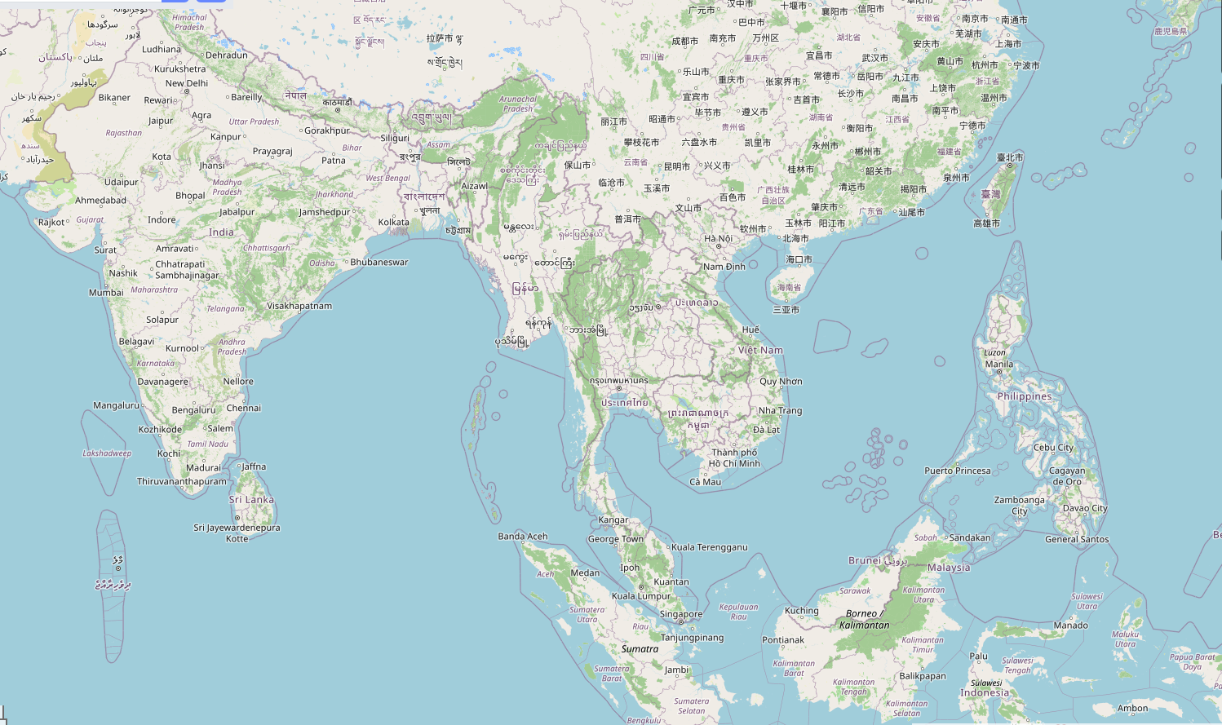


Diversity

Slide 12
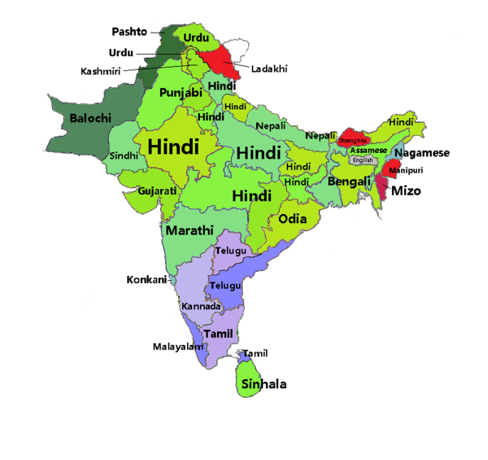
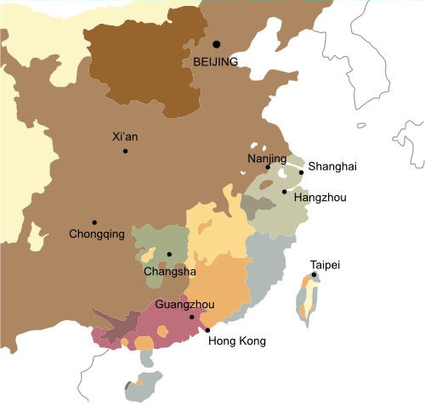


Diversity

Slide 13
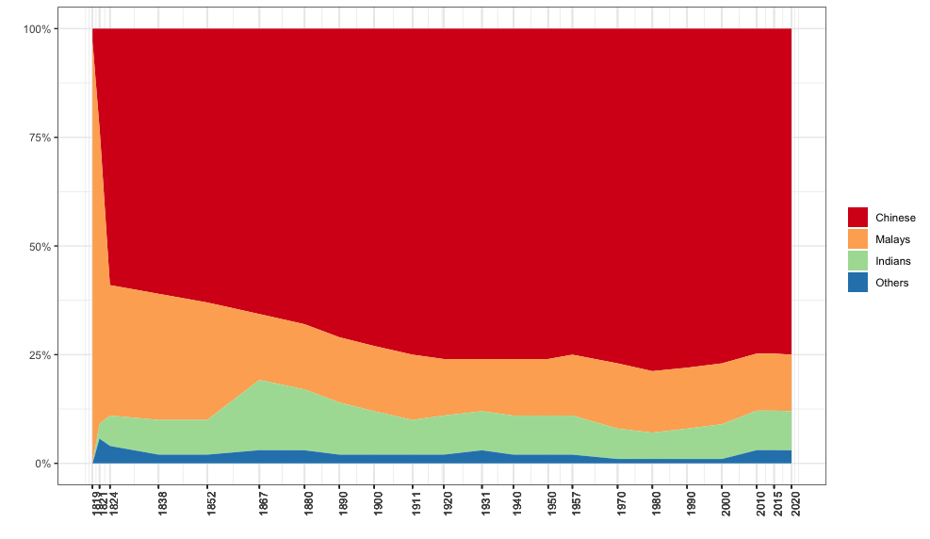
Diversity
Three major groups (Census 2020)
Malays recognised as ‘the indigenous people of Singapore’ (Constitution, cap. 152)

Slide 14
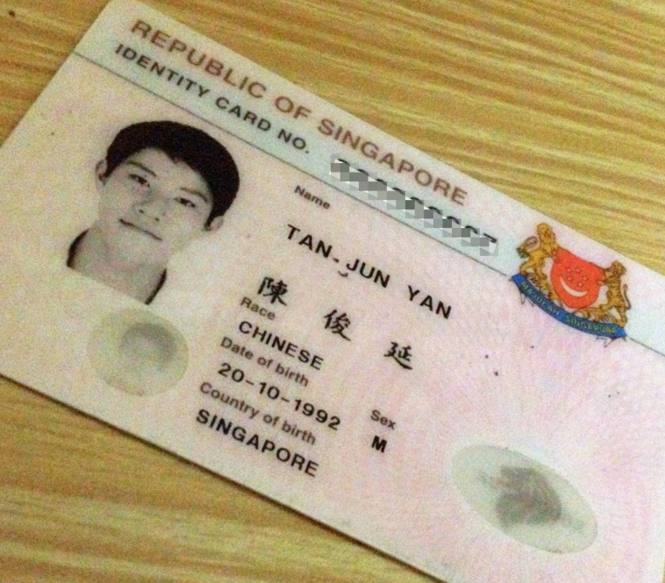
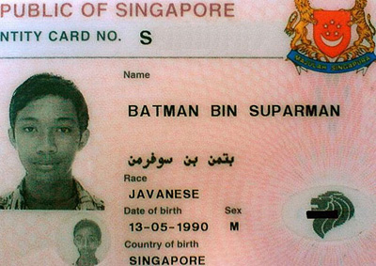


Diversity
Ethnicity, ‘race’
http://languagelog.ldc.upenn.edu/nll/?p=5
Notes:
The opposite of France ☺
Child took father‘s ethnicity up until 2011
Under colonial rule, ethnic groups were spatially segregated
Nowadays → Ethnic Integration Policy (EIP)
Annual racial harmony day (21 July)
Special position of the Malay population

Slide 15
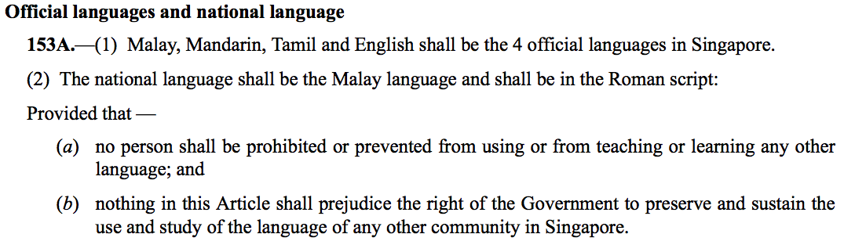
Diversity

Slide 16
Singapore(an) English(es)

Slide 17
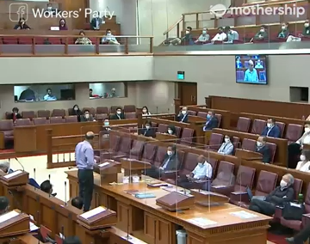
Example
https://www.youtube.com/watch?v=jbqdqevYUXA
Notes:
Tharman Shanmugaratnam, then Senior Minister for Social Policies
Parliamentary debate on minimum wages, September 2020
Listen out for interesting accent features.
non-rhotic (where, makers)
monophthongs in wage, exaggerate, so, low
no goose-fronting (to do)
final de-voicing in edges, differences, etc
staccato rhythm, little length distinction
entirely standard grammar

Slide 18
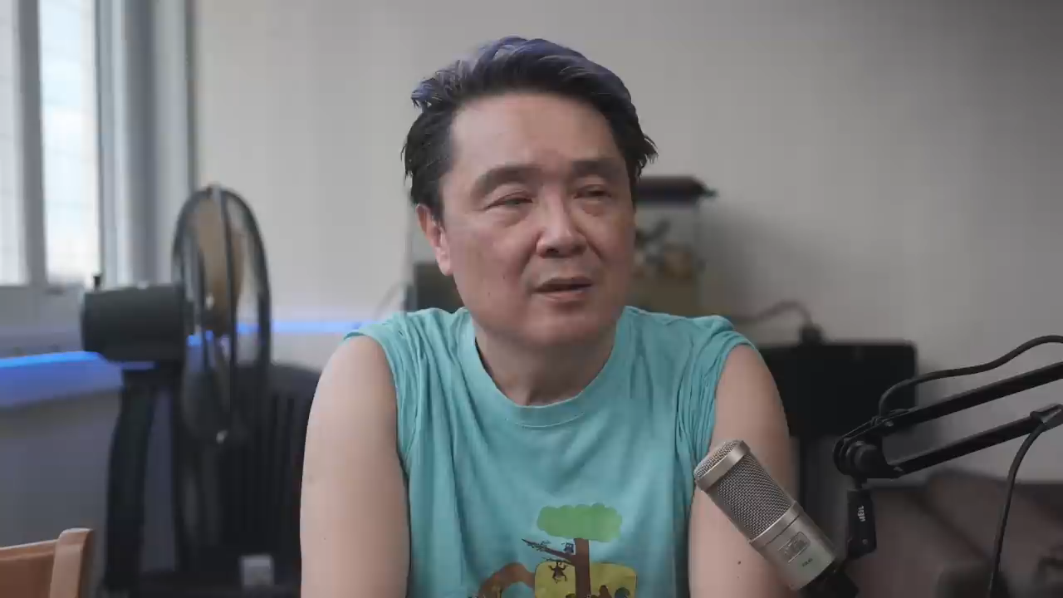
Example
https://www.youtube.com/watch?v=tC9giVz30pE
Notes:
Lee Kin Mun, mostly known as Mr. Brown. Here his character Kim Huat, commenting on the announcement of a new Prime Minister Lawrence Wong in 2024 (“Handover”)
Listen to see if you hear a difference
th = t (I think = I tink)
or-not tag question
got-existential (got coup, got riot)
-lah as listing particle (got coup lah, got riot lah)
overall intonation, final particle ah
our PM change_ (missing 3PL?)
generally pretty standard grammar in plural agreement

Slide 19



Singapore(an) English(es)
Standard (Singapore) English
  standard grammar
  some local lexis
  local phonology
Colloquial Singapore English (Singlish)
  mostly English lexis
  grammatical influences from substrate languages
  borrowing (mostly Hokkien and Malay)
slippers
to bathe

Slide 20
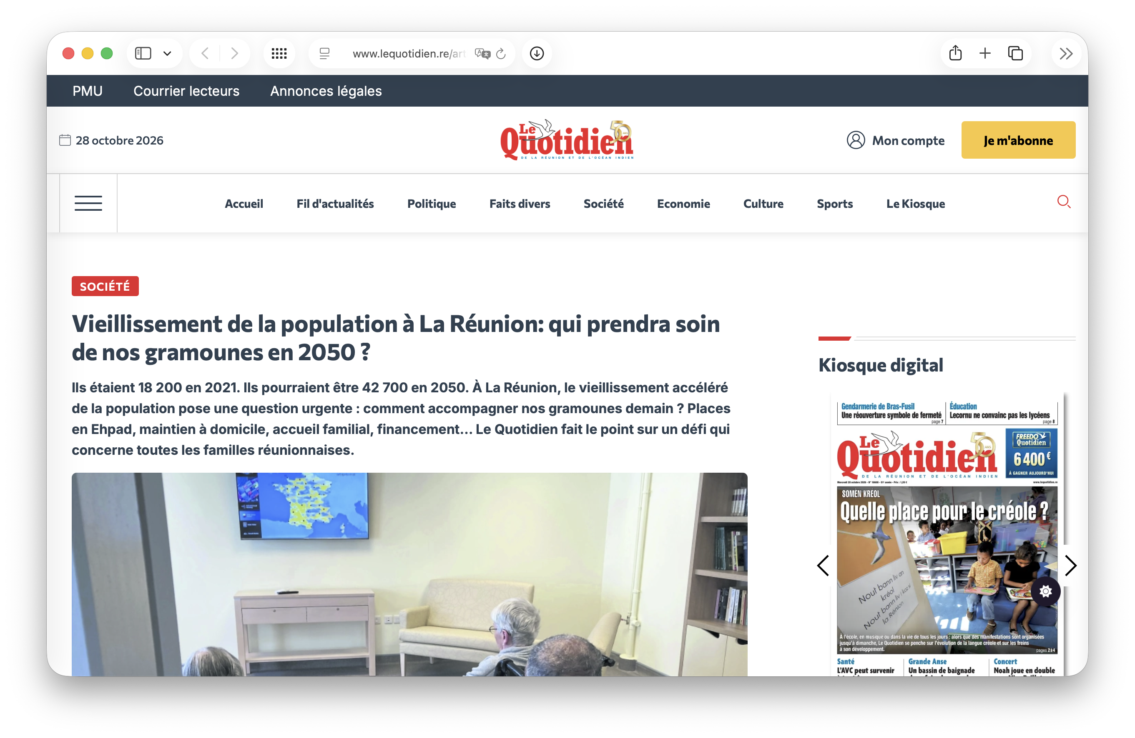
Notes:
Wiktionnaire: un/une gramoune = (La Réunion) Personne âgée.

Slide 21
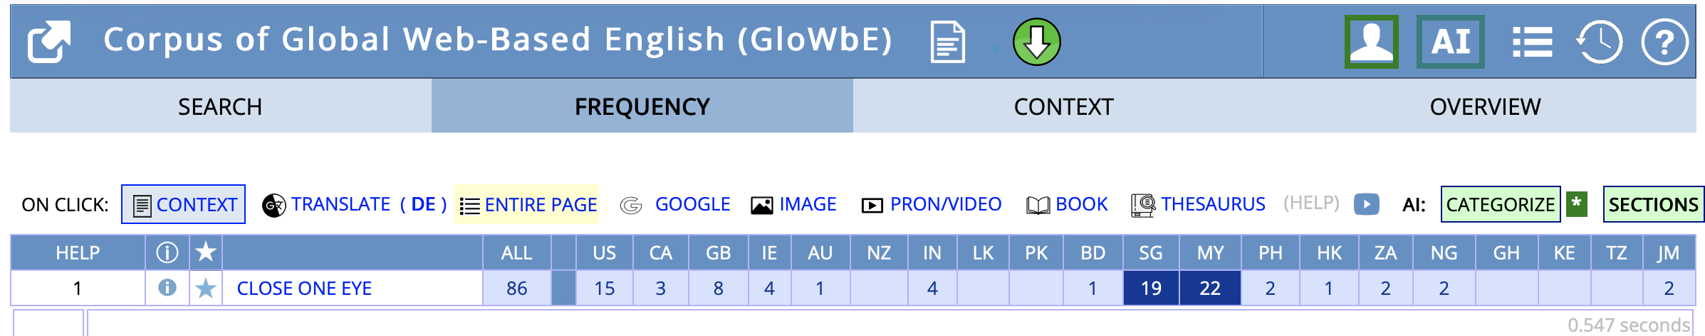
Singapore(an) English(es): Standard
‘close one eye’ in GloWbE

Slide 22
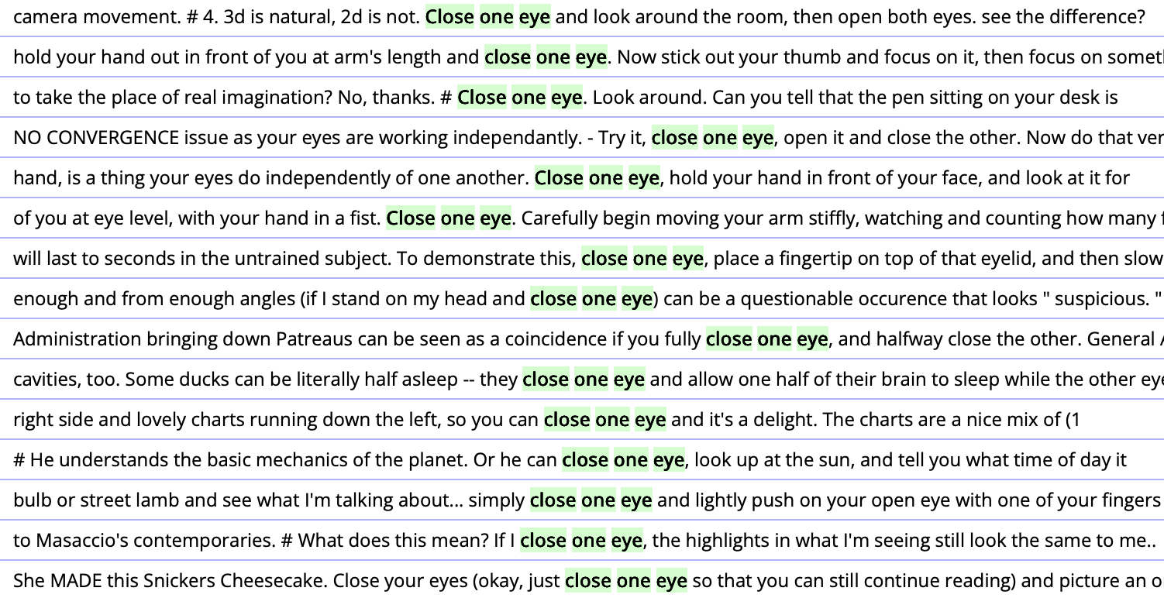
Singapore(an) English(es): Standard
‘close one eye’ (US)

Slide 23
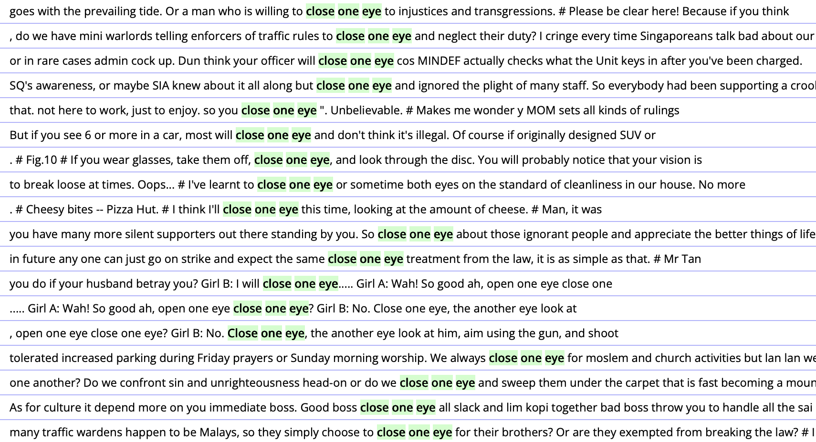
Singapore(an) English(es): Standard
‘close one eye’ (SG)

Slide 24


Singapore(an) English(es): Singlish

Slide 25
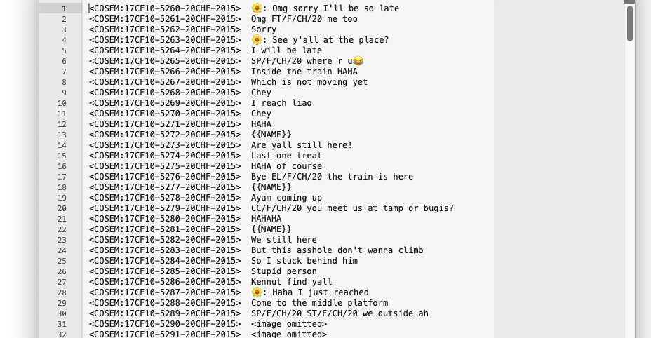
Singapore(an) English(es): Singlish

Slide 26
Singapore(an) English(es): Singlish
Pro-drop
Mm if later still dont have then Ø can do in suite or the tcher pantry there haha
<COSEM:19SF01-44969-22SGCHFST-2018>
Copula-deletion
So who Ø playing??
<COSEM:17CF02-1419-24SGMAM00-2016>
i Ø not going
<COSEM:17CF02-1437-22TWCHF00-2016>
Lack of inversion (in wh-questions)
Eh so meet at what time at where?
<COSEM:17CF10-6899-20SGCHF00-2016>
Variable past tense marking
i'm so sleepy cause yesterday i go watch all the buzzed unsolved mysteries and then madam tak boleh tidur
<COSEM:18MF03-9033-23SGMAF00-2017>
Variable 3sg agreement
like these few days she go everyday sia
<COSEM:21DC34-3614-21SGCHFNY-2018>
Invariant question tag
We watching infinity war at 5 is it
<COSEM:21DC03-4691-23SGCHM0K-2018>

Slide 27

Singapore(an) English(es): Singlish
If you feel sad then stop spreading this bad fact about him la
<COSEM:17CF15-35382-21CHF-2015>
Wah u very free ah
<COSEM:17CF31-4573-19CHF-2016>
I think everyone plan timetable first bah
<COSEM:17CF07-13341-22CHM-2016>
30th got school meh it's a Sunday Leh
<COSEM:17CF34-211-20CHF-2012>
I find the black emojis dam funny lor
<COSEM:17CF07-8854-21CHF-2015>
Sit where?? Still drizzling sia haha
<COSEM:17CM02-4764-21CHM-2016>
Quite obvious what
<COSEM:17IF03-3157-20INF-2014>
https://www.amazon.com/Singapore-Shiok-Lah-Singlish-Tshirt/dp/B0172NTRB0
Notes:
Substrate loans
Monosyllabic
Clause-final
Markers of informality
Stereotypes of the national variety
Actual use and variation unclear
Ethnicity (Platt 1987, Begum & Kandiah 1997, Gupta 2006, Leimgruber 2009, Smakman & Wagenaar 2013, Botha 2018)

Slide 28
Singapore(an) English(es): Singlish
Discourse particles
lah | draws attention to mood or attitude and appeals for accommodation; indicates solidarity, familiarity, informality (Lim 2007)
ah | signals continuation and keeps interlocutors in contact; softens command; marks a question expecting agreement […] [or] requiring response (Lim 2007)
what/ wor | indicates that information is obvious, contradicting something previously asserted (Lim 2007)
lor | indicates a sense of obviousness as well as resignation (Lim 2007)
hah | marks wh- or declarative question, or asks for repetition (Wee 2004)
hor | asserts and elicits support for a proposition (Gupta 1992)
leh | equivalent to ‘what about?’ (Platt 1987) marks a tentative suggestion or request (Wee 2004)
meh | marks a question involving scepticism (Lim 2007)
mah | indicates obviousness (Lim 2007)
bah | marks uncertainty or non-commitment, has a hedging effect when giving advice (Leimgruber 2016)
sia | intensifier: coarseness, coolness solidarity marking, casual, youth identity (Hiramoto et al. 2017)

Slide 29
Singapore(an) English(es)
Schneider (2007): The dynamic model of post-colonial Englishes
Foundation
Exonormative stabilisation
Nativisation
Endonormative stabilisation
Differentiation
History & politics
History & politics
History & politics
History & politics
History & politics
History & politics
Linguistic develop-ments
Linguistic develop-ments
Linguistic develop-ments
Linguistic develop-ments
Linguistic develop-ments
Identity re-writings
Identity re-writings
Identity re-writings
Identity re-writings
Linguistic develop-ments
Identity re-writings
Identity re-writings
Socio-linguistic conditions
Socio-linguistic conditions
Socio-linguistic conditions
Socio-linguistic conditions
Socio-linguistic conditions
Socio-linguistic conditions
Schneider (2007), as in Buschfeld et al. (2014: 6), Buschfeld & Kautzsch (2017: 107)
Notes:
Foundation phase: fist contact between colonisers (or settlers) and indigenous
Endonormative stabilization: cultural self-reliance, nation-building, recognised localized form, codification, homogeneity
Differentiation: established stable nation, sub-national identities emerge, group-internal markers, regional/ethnic/social dialects
Singapore: phase 4, traces of 5 visible

Slide 30
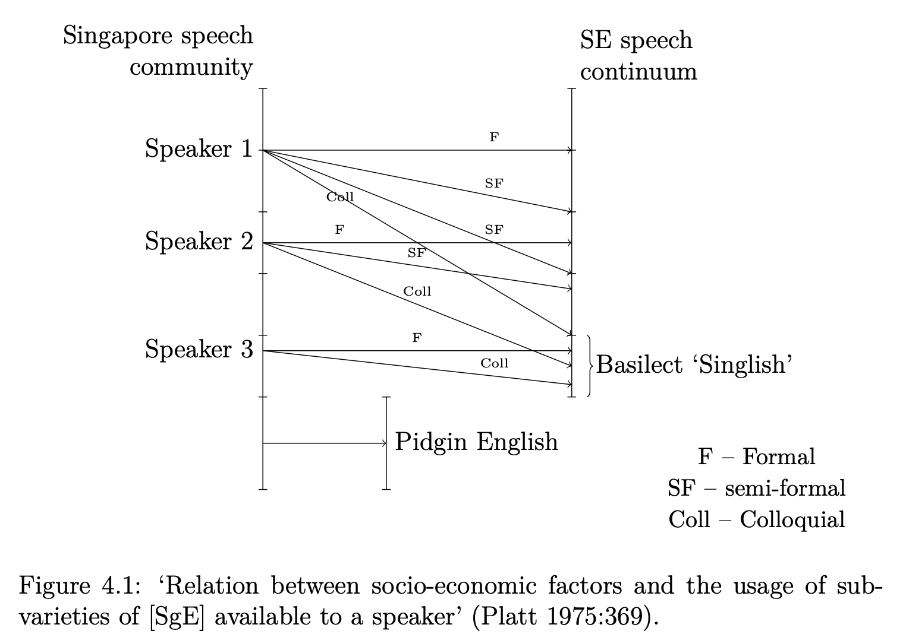
Singapore(an) English(es)

Slide 31
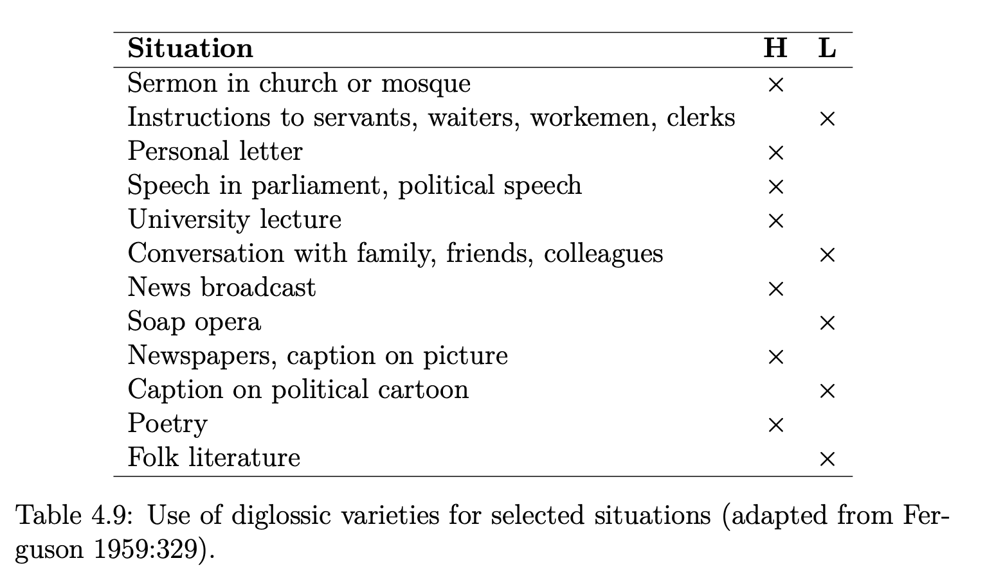
Singapore(an) English(es): Diglossia

Slide 32
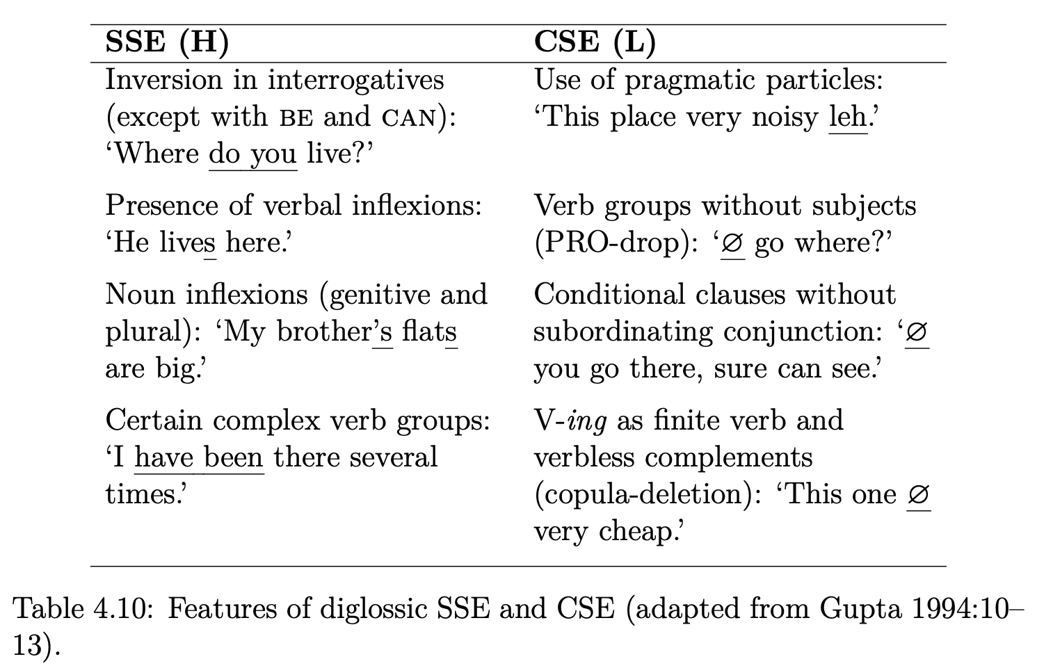
Singapore(an) English(es): Diglossia

Slide 33
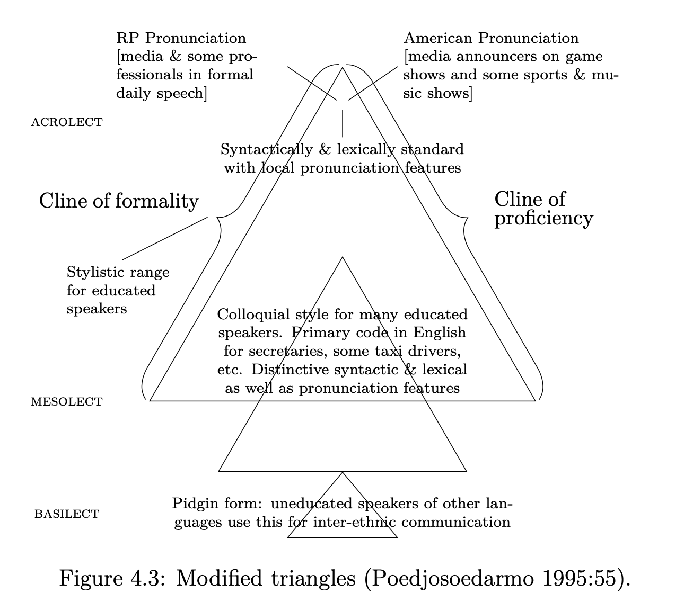
Singapore(an) English(es)

Slide 34
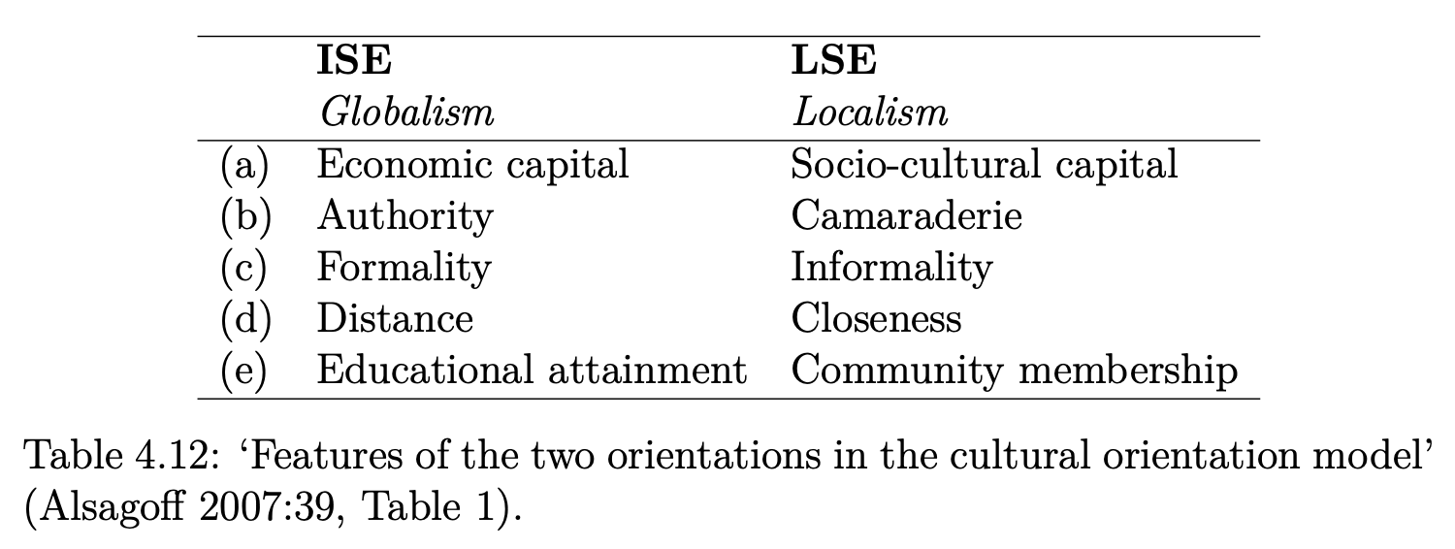
Singapore(an) English(es)

Slide 35
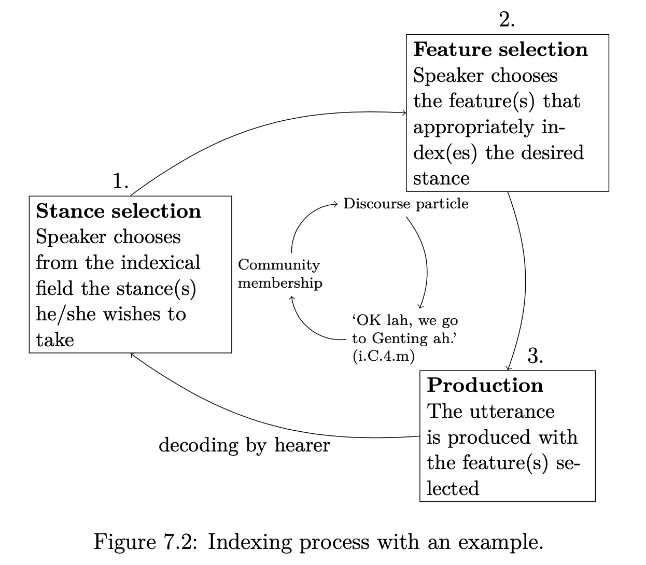
Singapore(an) English(es): Indexicality

Slide 36
Singlish: Case study
Tag questions
(Standard) English has (needlessly?) complex rules for its tag questions, requiring agreement in:
gender
number
person
tense
and more:
reversal of polarity
restricted to the right periphery
✔️She is hungry, isn’t she? [3sg.f, prs]
*She is hungry, isn’t he? [gender mismatch]
*She is hungry, aren’t they? [number mismatch]
*She is hungry, aren’t I? [person mismatch]
*She is hungry, wasn’t she? [tense mismatch]
✔️She is hungry, isn’t she? [pos/neg]
✔️She isn’t hungry, is she? [neg/pos]
*She isn’t hungry, isn’t she? [neg/neg]
*%She is hungry, is she? [pos/pos]
%Your car is outside, is it? [non-canonical, Quirk et al 1985: 812]
️She is hungry, isn’t she? [right periphery]
*Isn’t she, she is hungry? [left periphery]

Slide 37
Singlish: Case study
Perhaps unsurprisingly, several varieties of English have other tag question rules
Colloquial Singapore English: invariant is it
(Leimgruber, 2011; Wong, 2014)
CSE is it
Functionally: No expectation of agreement or response
Structurally: Rarely used canonically (with reversed polarity)
Innovative clause-initial use
it’s not their problem is it
<ICE–SIN:S1A–062#89:1:B>
It is too sweet is it?
‘It is too sweet, isn’t it?’
<ICE–SIN:S1A–052#130:1:C>
​Is it everyone likes Jane Austin?
‘Does everyone like Jane Austin?’
<ICE–SIN:S1A–078#172:1:B>
​Issit u fly aeroplane
‘Did you fly here via airplane?’
<COSEM:18CF52–11845–21CHM– 2016>
Notes:
Functionally: the tag doesn't trigger a response
Structurally: polarity reversal can happen, but is rare
Clause-initial use: not found in StdE

Slide 38
Singlish: Case study
Context | Form | Example | BNC (British English) | CoSEM (Singapore English) | Significance testing
is it | polarity-observing | It's nice for some, working part-time [+], isn't it [-]? | 285 (57%) | 21 (7%) | χ²(1, N = 812) = 206.7 p < 0.001 ***
 | non-polarity observing | Oh, it's you [+], is it [+]? Giving you trouble [+], is it [+] | 215 (43%) | 291 (93%)
is it + neg (i.e., isn’t it, is it not, it isn’t) | polarity-observing | It's not, though [-], is it? [+] | 557 (100%) | 20 (95%) | Fisher exact test statistic = 0.0363 p < 0.05*
 | non-polarity observing | Now no space what [-] isn't it [-] ? | 0 (0%) | 1 (5%)

Slide 39
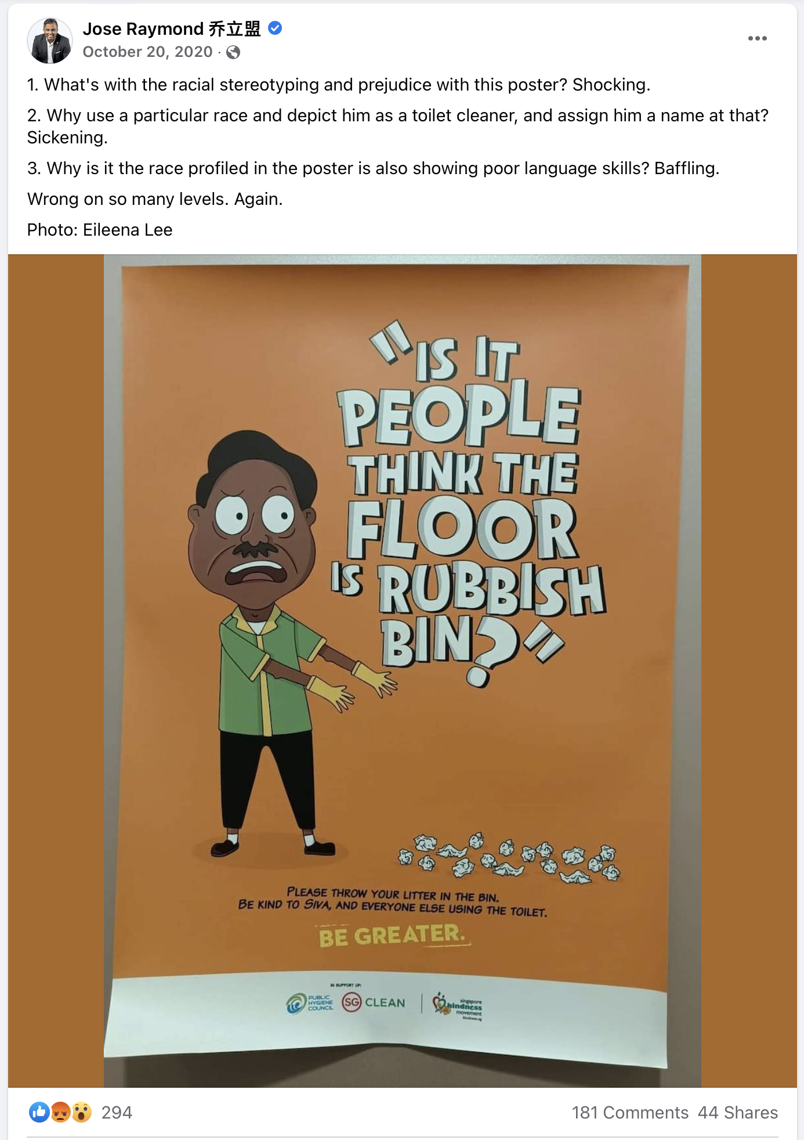
Jose Raymond 乔立盟. (2020, October 20). 1. What’s with the racial stereotyping and prejudice with this poster? Shocking.
2. Why use a [Photo with comment]. Facebook. https://www.facebook.com/JoseRaymondThomas/posts/pfbid0Ux7aAKt9AeWZvdJzGExYfDRvr829pE5kXqcCmKrR2xwx81rGVr8gvMsmRcTbfsQsl
Notes:
Thanks to David Teh for pointing this out to me. (SKM 2020 campaign, some controversy online)
3. Why is it the race […] → We’re here not taking instances into account with wh-words before the is-it element, but I think we agree that this sentence, with or without the “why”, is (ironically, too) not in line with the standard grammar that the poster is probably invoking when he chastises “poor language skill”.

Slide 40
English in Singapore

Slide 41
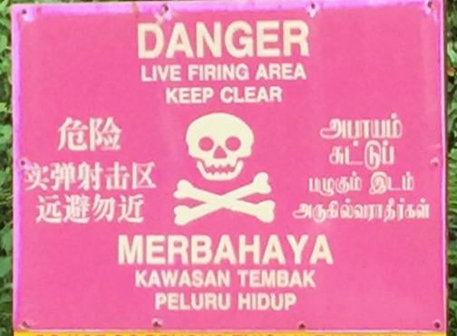
English in Singapore: Language policies
Officially quadrilingual (Malay, Mandarin, Tamil, English)

Slide 42
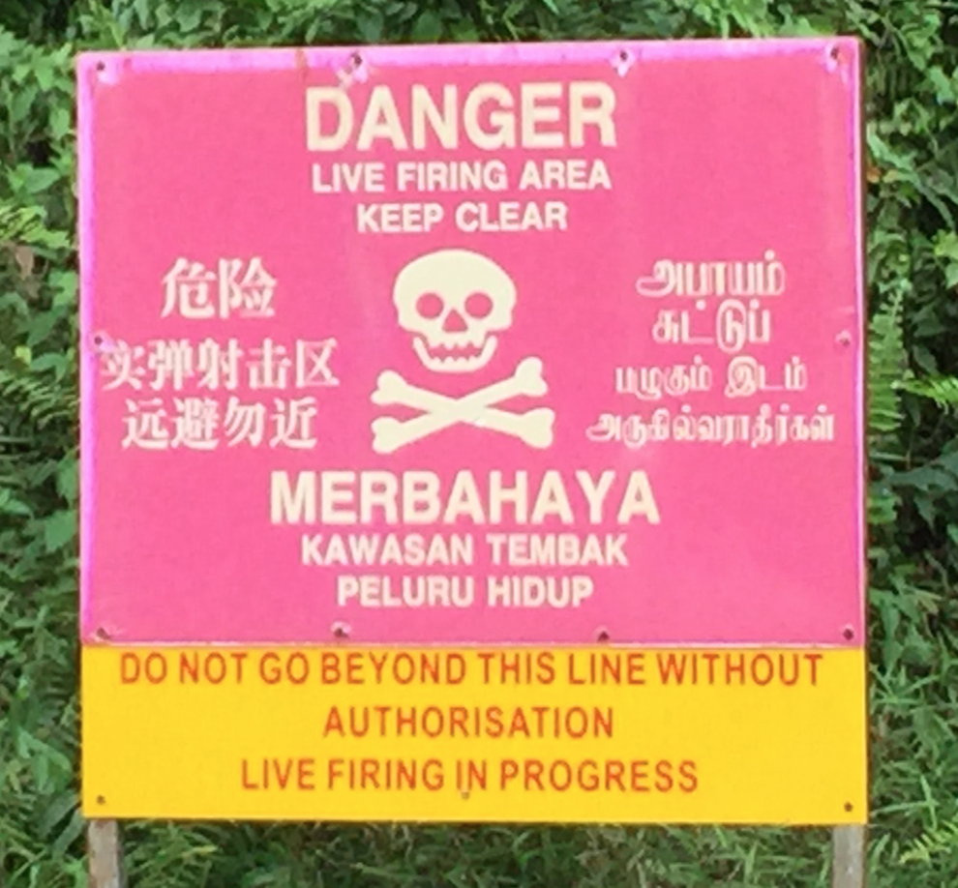
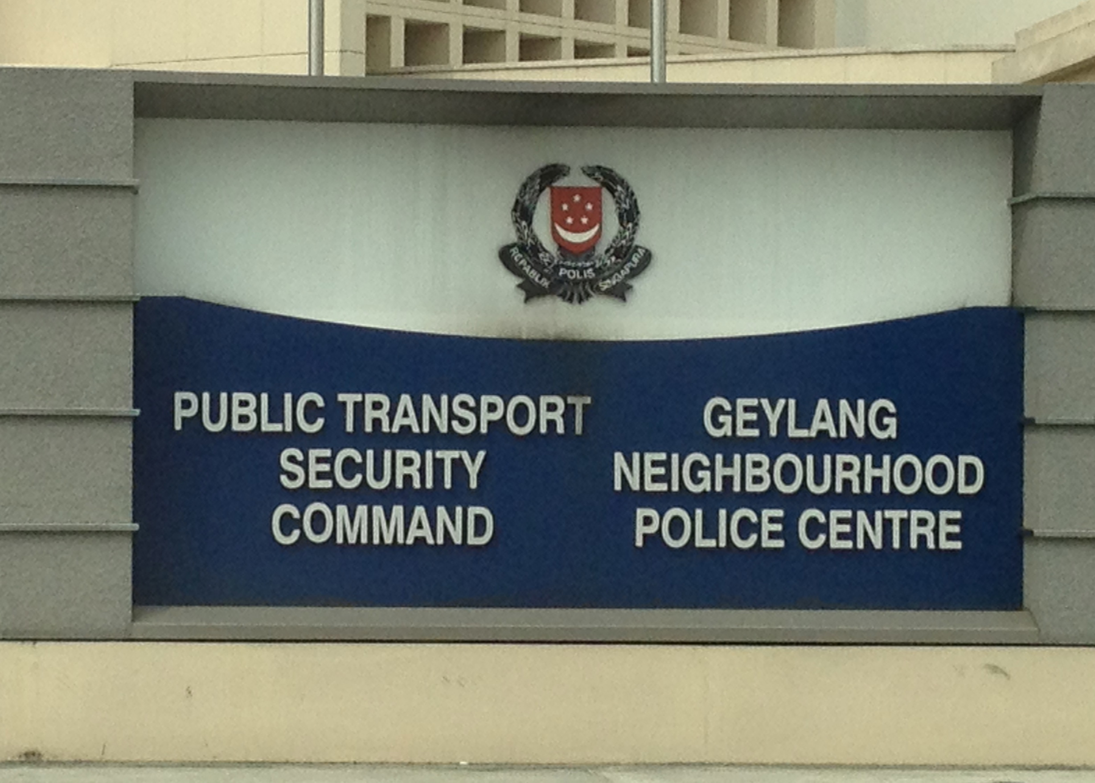
English in Singapore: Language policies
Officially quadrilingual (Malay, Mandarin, Tamil, English)
But: English = ‘working language’ of the state, sole medium of instruction

Slide 43
English in Singapore: Language policies
Officially quadrilingual (Malay, Mandarin, Tamil, English)
But: English = ‘working language’ of the state, sole medium of instruction
But: ‘mother tongue’ policy
English
Mandarin
Hokkien | Teochew
Hainanese | Cantonese
Hakka | Toishanese
Henghua | Etc…
Tamil
Tamil | Telugu
Malayalam | Punjabi
Hindi/Urdu | Gujarati
Bengali | Etc…
Malay
Malay | Javanese
Indonesian | Bugis
Boyanese | Duano
Minangkabau | Etc…

Slide 44
English in Singapore: Language policies
Officially quadrilingual (Malay, Mandarin, Tamil, English)
But: English = ‘working language’ of the state, sole medium of instruction
But: Mother tongue policy
→ Mandarin: promotion within the Chinese community (‘Speak Mandarin Campaign’ since 1979)
https://www.jeraldinephneah.com/importance-of-dialects-in-singapore/

Slide 45
English in Singapore: Language policies
Rationale
‘’ | We must not burden our children with dialects. Drop dialects, don’t let children speak dialects. In fact, dialects have no economic value in Singapore. Their cultural value is also very low. English has economic value. Mandarin has cultural value and will also have economic value 20 years later. Lee Kuan Yew, quoted in Bokhorst-Heng (1998)

Slide 46




English in Singapore: Language policies
Malay = ‘official’ and ‘national’ language
Notes:
Malay on crests (state, police, army, poly) “first and foremost”; “To Serve with Mastery”

Slide 47
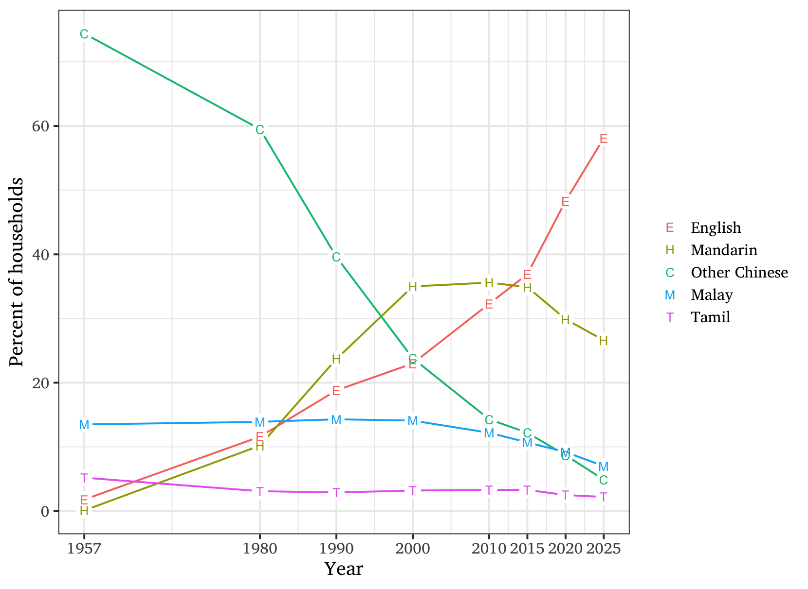
English in Singapore: Language shift
Effects:
Dominant household language

Slide 48
English in Singapore: Language shift
Effects
Notes:
Moving on to English use within different ethnicities...
We don't know if this is Singlish or English!
Singlish has long been fought by the government.

Slide 49
English in Singapore: Language policies
‘’ | Singlish is not English. It is English corrupted by Singaporeans and has become a Singapore dialect. […] Singlish is broken, ungrammatical English sprinkled with words and phrases from local dialects and Malay which English speakers outside Singapore have difficulties in understanding. […] If they [the younger generation] speak Singlish when they can speak good English, they are doing a disservice to Singapore Goh Chok Tong (Speech on 29 August 1999)
Notes:
I am not referring to accent here. Our Singaporean accent is acceptable. We do not need to fake an American or British accent.

Slide 50

English in Singapore: Language policies
Speak Good English Movement https://www.languagecouncils.sg/goodenglish/
Notes:
have a look at the website

Slide 51
English in Singapore: Language policies
‘’ | The more the media makes Singlish socially acceptable, by popularising it in TV shows, the more we make people believe that they can get by with Singlish. This will be a disadvantage to the less educated half of the population. Lee Kuan Yew (Speech)

Slide 52
English in Singapore: Language policies
Media Development Authority: Free-to-air television programme code
‘’ | Standard English, which is grammatically correct, should be used for programmes such as news, current affairs and info-educational programmes. Local English, which is also grammatically correct but pronounced with a Singaporean accent and which may include local terms and expressions, could be used for programmes like dramas, comedies and variety shows. [...] Singlish, which is ungrammatical local English, and includes dialect terms and sentence structures based on dialect, should not be encouraged and can only be permitted in interviews, where the interviewee speaks only Singlish. The interviewer himself, however, should not use Singlish. (MDA 2013: 12, my emphasis)

Slide 53
Current changes

Slide 54
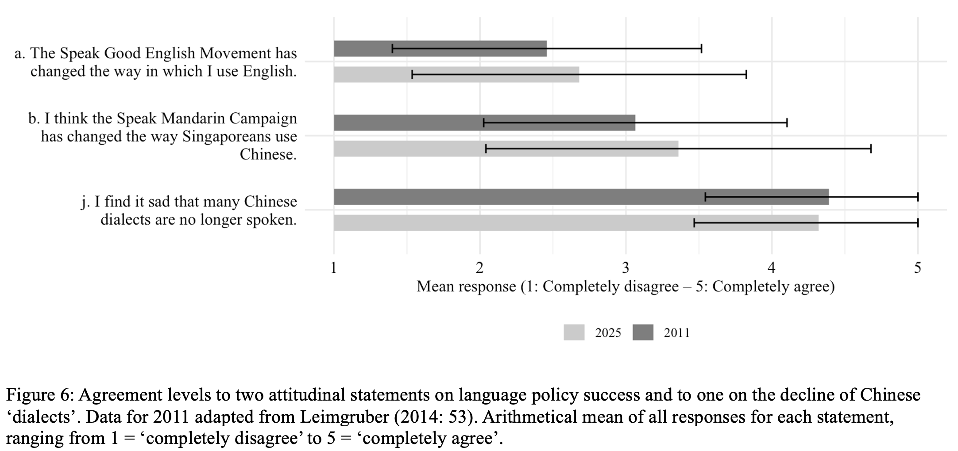
Current changes: Attitudes towards policies
Leimgruber (fthc)

Slide 55
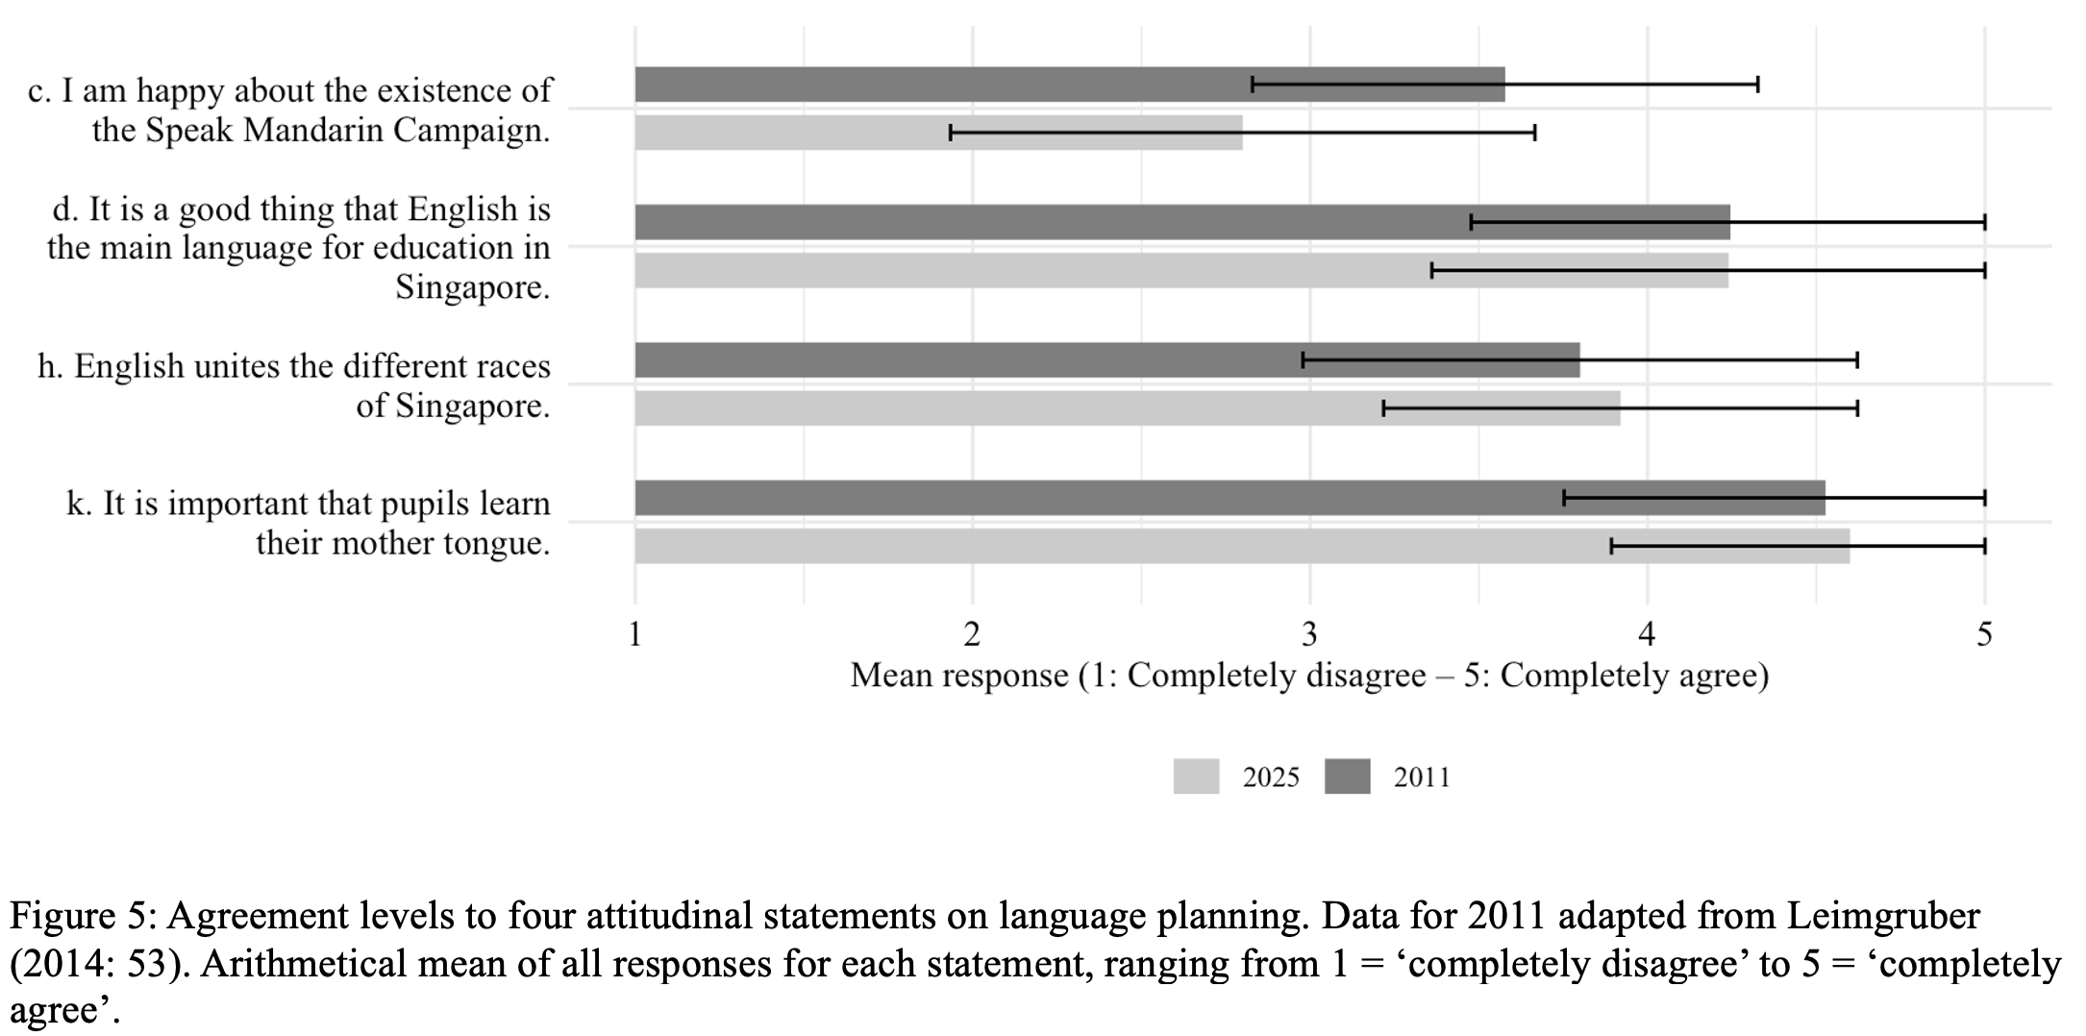
Current changes: Attitudes towards policies
Leimgruber (fthc)

Slide 56
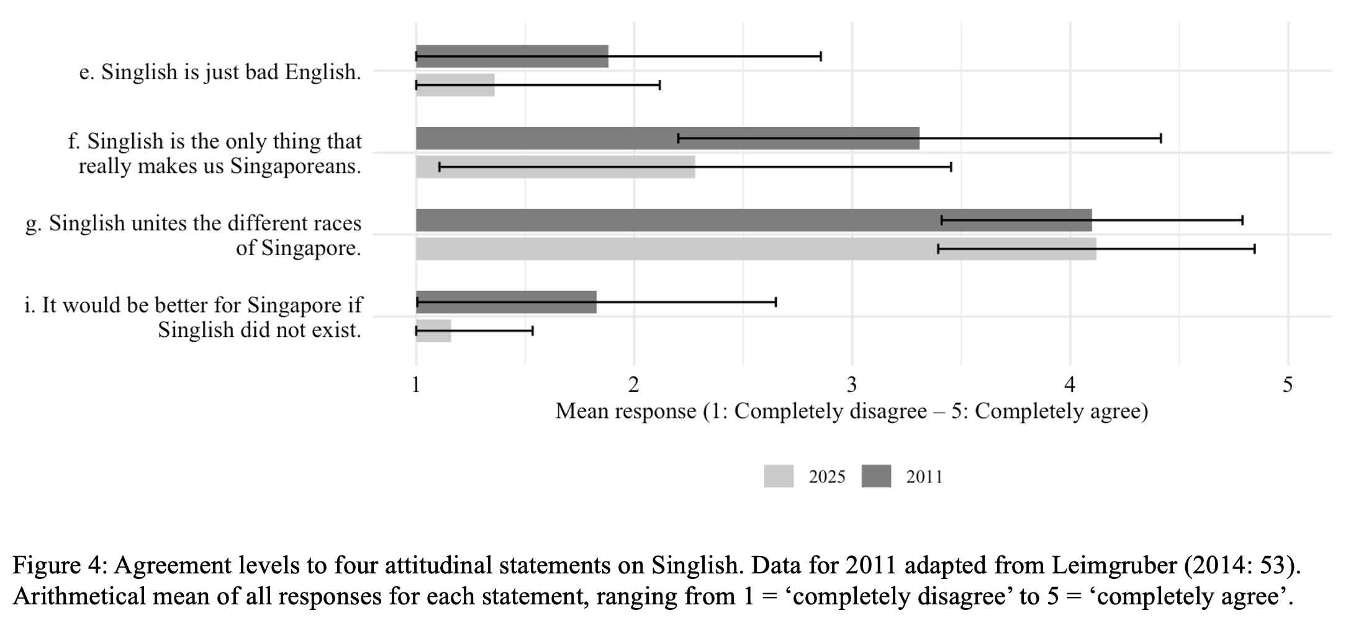
Current changes: Attitudes towards Singlish
Leimgruber (fthc)

Slide 57
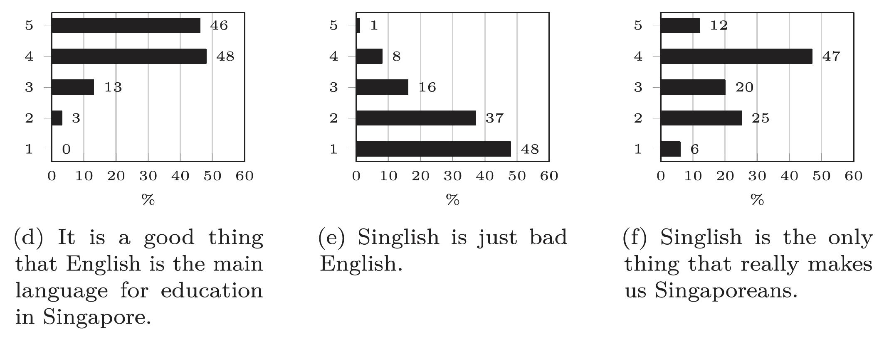
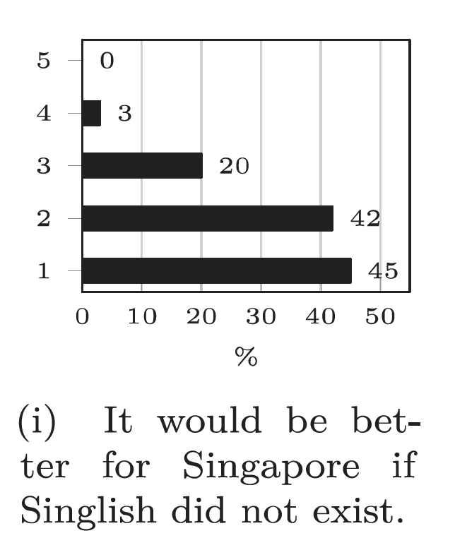
Current changes: Attitudes towards Singlish
Leimgruber (2014: 53)
5 = completely agree,
1 = completely disagree

Slide 58
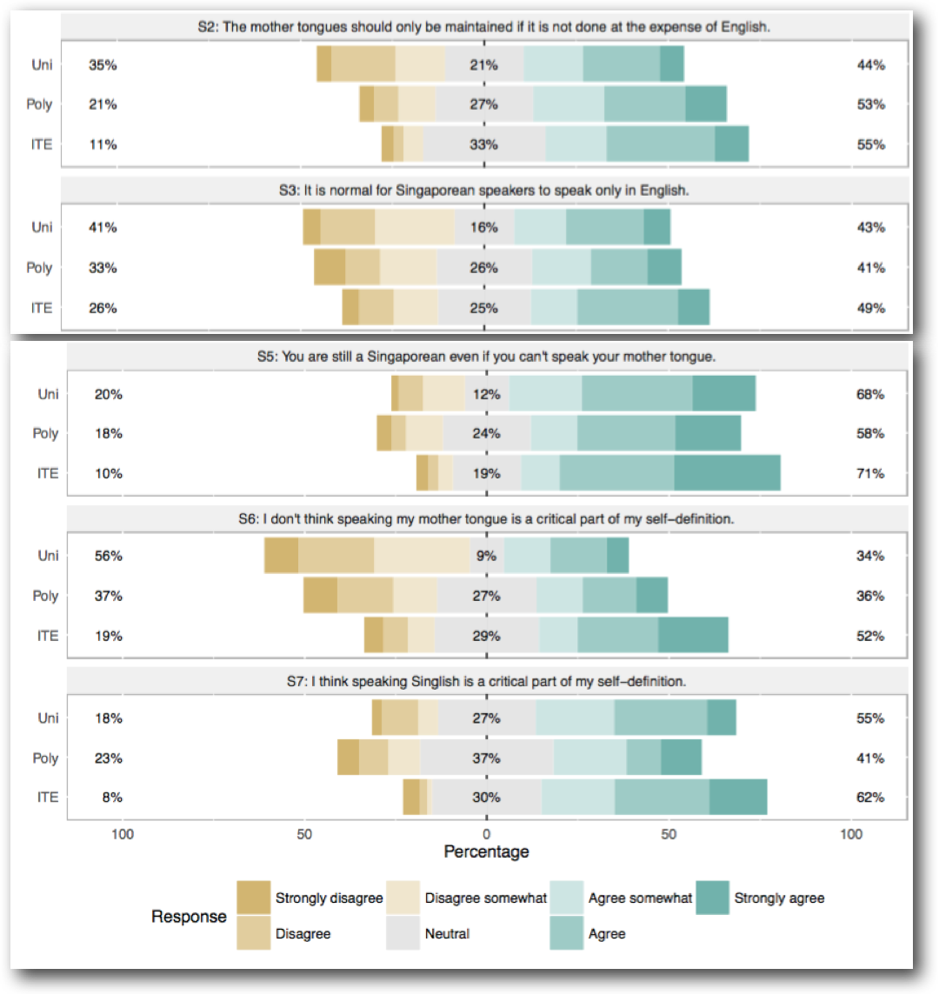
Current changes: Attitudes towards Singlish
Leimgruber et al (2018)

Slide 59
Current changes: Attitudes towards Singlish
Rationale
‘’ | The Speak Good English Movement recognises the existence of Singlish as a cultural marker for many Singaporeans. We aim to help those who speak only Singlish, and those who think Singlish is English, to speak standard English. It is important to understand the differences between standard English, broken English and Singlish. Speak Good English Website (accessed 22 April 2024)
Notes:
so now Singlish ≠ broken

Slide 60

Current changes: Attitudes towards Singlish
Notes:
govt entities utilizing singlish. acknowledgement of identity-bearing functions.

Slide 61
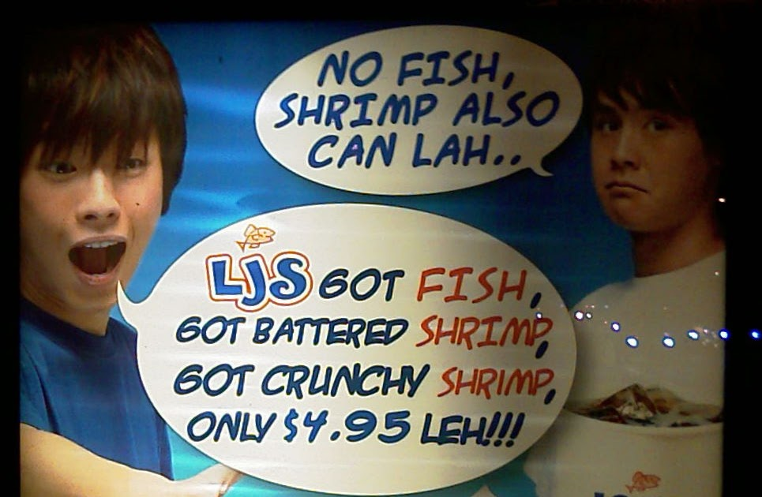
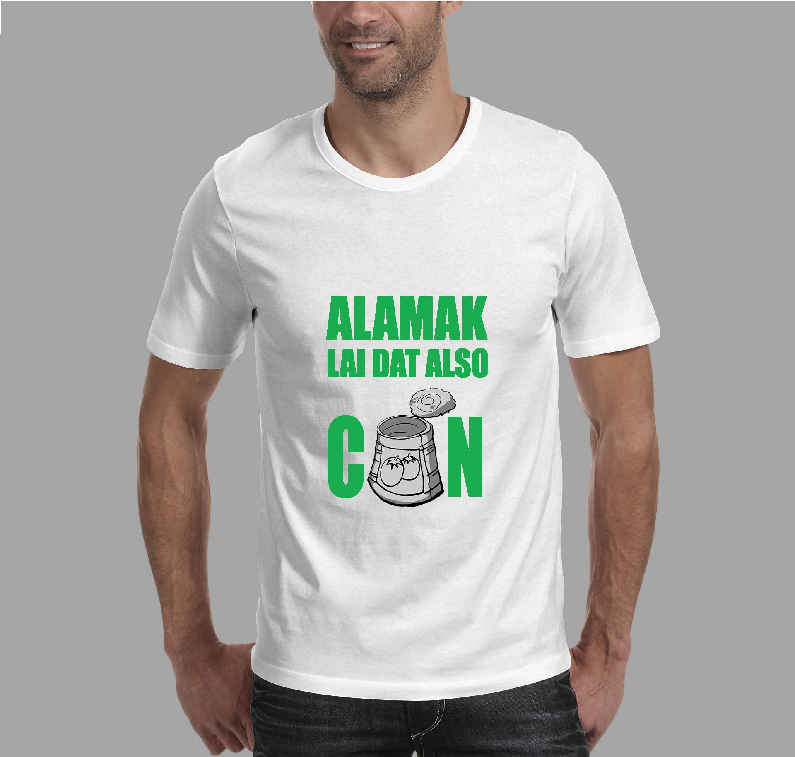
Current changes: Attitudes towards Singlish
http://2.bp.blogspot.com/_lZhFzUaWLT8/Rtz59Mmn_1I/AAAAAAAAATA/OslftoVLo2k/w1200-h630-p-k-no-nu/IMAG0009.jpg
https://i.pinimg.com/originals/83/ff/15/83ff1580546e172e0d6a2cd68d819976.jpg

Slide 62
Current changes: Attitudes towards Singlish
Speak Good Singlish Movement
‘’ | We not against Speak Good English Movement in Singapore hor. But we feel people should get it right with speaking Singlish and not just English. We are damn tired of people confusing Singlish with broken English. We are damn tired of people kay-kay speak Singlish but really speak bad English. We are damn tired of people picturing Singlish speakers as obiang chow Ah Bengs and Ah Lians. You dun wanna learn the subtle rules of this natural evolving language, then dun anyhow say it is simple, shallow, and useless please! Singlish is full of culture, of nuances and wordplay. It pulls together the swee-ness in the grammar, syntax, and vocabulary of so many languages. Best OK! (Facebookpage SGS, quoted in Wee 2014: 88)

Slide 63
Current changes: Generational Singlish
Vernacular = ongoing language change
Many descriptions of Singlish have a generational bias

Slide 64
Current changes: Generational Singlish
Vernacular = ongoing language change
Many descriptions of Singlish have a generational bias

Slide 65
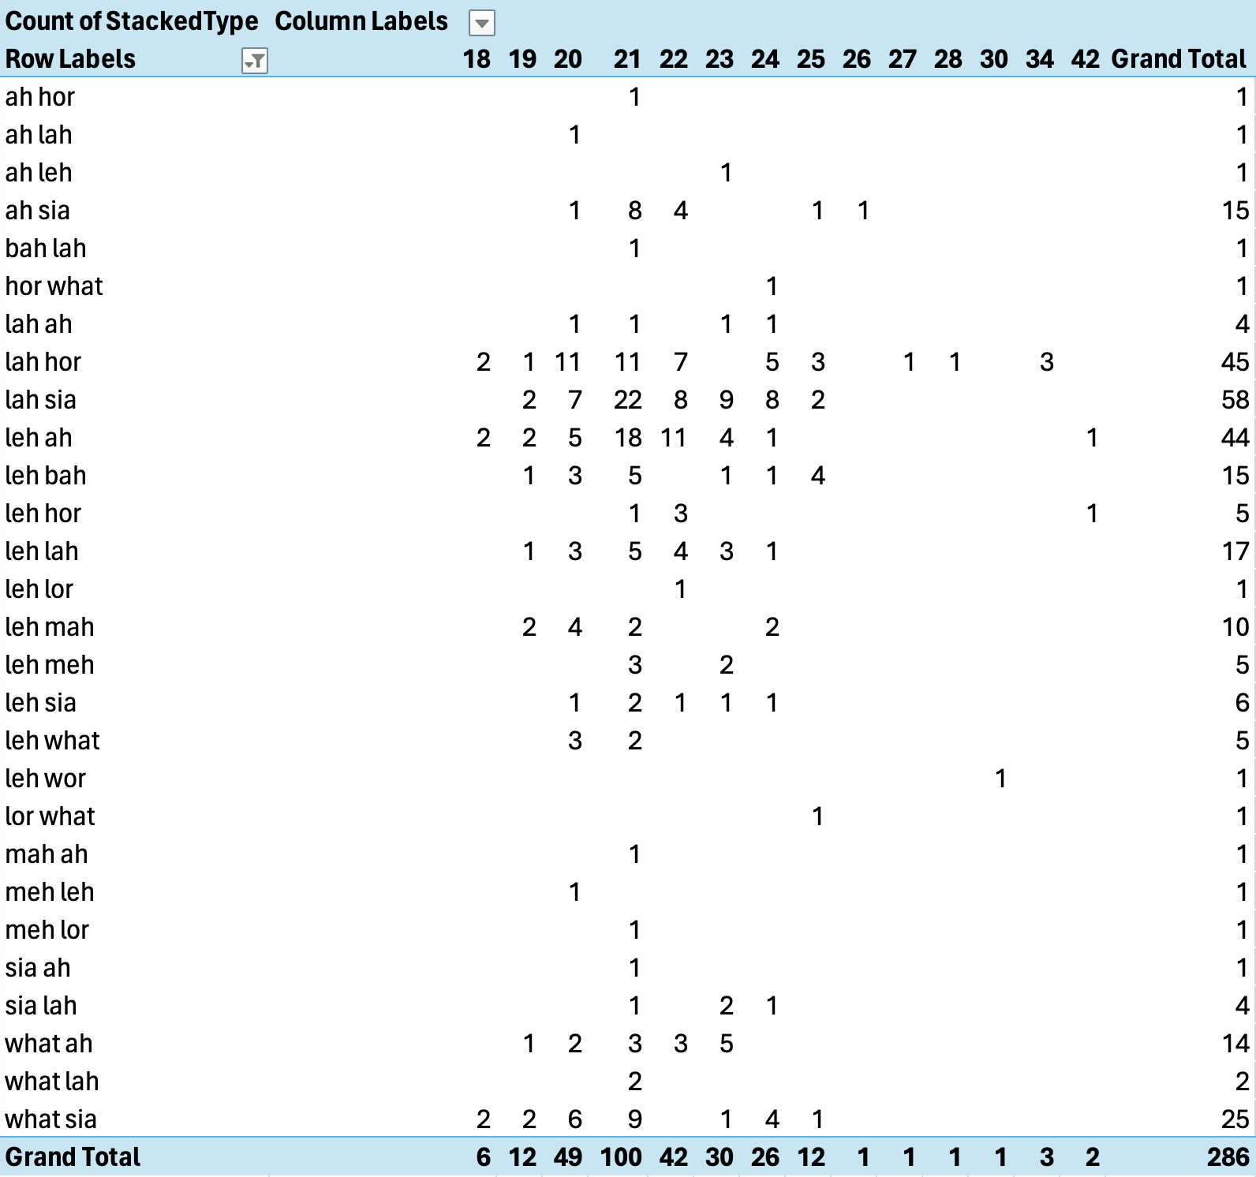
Current changes: Generational Singlish

Slide 66
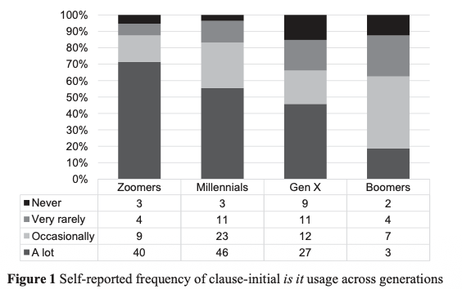
Current changes: Generational Singlish
wa is it you think i wuliao
‘Wow, are you saying that I am boring?’
<COSEM:18CF59–2829–20CHF–2017>
Leimgruber et al. (2026)

Slide 67
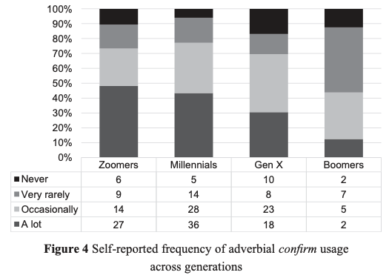
Current changes: Generational Singlish
Aiyah I will confirm be late
‘Damn, I will definitely be late.’
<COSEM:18CF47-1636-20CHF-2017>
Leimgruber et al. (2026)

Slide 68
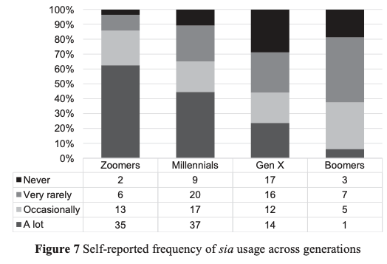
Current changes: Generational Singlish
How much honey he buy sia
‘How much honey did he buy?!’
<COSEM:18CF42-1803-23MAF-2016>
Leimgruber et al. (2026)

Slide 69
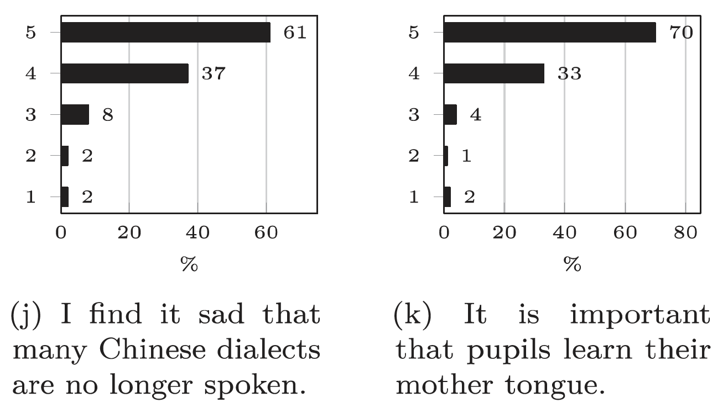
Singapore
Leimgruber (2014: 53)
5 = completely agree,
1 = completely disagree
Notes:
What does that tell you about language family policies??

Slide 70
Singapore
Speak Good English Movement
Five main themes (Bruthiaux 2010: 104)
a concern for respectability, not intelligibility
linguistic descriptions used in support of SGEM aims are often incomplete, unconvincing, and occasionally plain wrong
detailed advice on usage harks back to a tradition of prescriptivism
little evaluation […] on the effectiveness
intervention by government in all spheres of Singapore life
“the SGEM project is a slick but confused, confusing, outdated, and ultimately irrelevant case of governmental overreach” (Bruthiaux 2010: 104)

Slide 71
Singapore
Speak Good Singlish Movement
‘’ | The Speak Good Singlish Movement represents a good example of linguistic chutzpah, where speakers demonstrate confidence in their language choices while also having the metalinguistic awareness and sophistication needed to articulate rationales for these choices. (Wee 2014: 85)

Slide 72

Singapore
http://www.cinemaonline.sg/movies/details.aspx?search=2013.8643.armydaze.16402
Notes:
Example of the army (NS) as a breeding ground for Singlish. Officially: English. Symbolically: Malay. In practice: Singlish.
Film allowed in Singlish.

Slide 73
Take-home messages

Slide 74
Take-home messages
Singapore: an English-dominant multilingual society, with continuing contact between language systems
Complex language policy context, with effects on language use
Well-described but constantly evolving vernacular

Slide 75
Thank you
for your attention
谢谢
Terima kasih
நன்றி
Merci/Mersi

Slide 76
References
Bokhorst-Heng, W. 1998. Singapore’s Speak Mandarin Campaign: Language ideological debates in the imagining of the nation. In Jan Blommaert (ed.), Language ideological debates, 235–265. Gruyter.
Buschfeld, S., & Kautzsch, A. 2017. Towards an integrated approach to postcolonial and non-postcolonial Englishes: Towards an integrated approach to postcolonial and non-postcolonial Englishes. World Englishes, 36(1), 104–126.
Buschfeld, S., Hoffmann, T., Huber, M., Kautzsch, A., & Schneider, E. W. (Eds.). 2014. The evolution of Englishes: The dynamic model and beyond. Benjamins.
Gonzales, W. D. W, M. Hiramoto, J. R. E. Leimgruber, Lim J. J. 2023. The Corpus of Singapore English Messages (CoSEM). World Englishes 42.2: 371–388.
Gonzales, W. D.W, M. Hiramoto, J. R. E. Leimgruber & Lim J. J. 2023. Is it in Colloquial Singapore English. English Today 39.4: 243–256.
Gupta, A. F. 1992. The pragmatic particles of Singapore colloquial English. Journal of Pragmatics, 18(1), 31–57.
Gupta, A. F. 1994. The step-tongue: children’s English in Singapore. Multilingual Matters.
Hiramoto, M., W. D. W. Gonzales, J. R. E. Leimgruber, Lim J. J. & J. Choo. 2022. From Malay to Colloquial Singapore English: A case study of sentence-final particle sia. In A. Ngefac, H.-G. Wolf & T. Hoffmann (eds) World Englishes and Creole Languages Today, Vol. 1: The Schneiderian Thinking and Beyond, 117–130. LINCOM.
Leimgruber, J. R. E. 2009. Modelling variation in Singapore English [DPhil thesis]. University of Oxford.
Leimgruber, J. R. E. 2011. Singapore English. Language and Linguistics Compass, 5(1), 47–62.
Leimgruber, J. R. E. 2014. Singlish as defined by young educated Chinese Singaporeans. International Journal of the Sociology of Language, 2014(230).
Leimgruber, J. R. E. 2016. Bah in Singapore English. World Englishes, 35(1), 78–97.
Leimgruber, J. R. E. fthc. Singaporeans’ language attitudes: Constants and shifts. In G. Regnoli & M. Westphal (eds) Language attitudes and World Englishes: Methods, insights, and challenges. EUP.
Leimgruber, J. R. E., Siemund, P., & Terassa, L. 2018. Singaporean students’ language repertoires and attitudes revisited. World Englishes, 37(2), 282–306.
Leimgruber, J. R. E., Lim J. J., W. D. W. Gonzales, & M. Hiramoto. 2020. Ethnic and gender variation in the use of Colloquial Singapore English discourse particles. English Language and Linguistics 25.3: 601–620.
Leimgruber, J. R. E., Gonzales, W. D. W., Hafiz, M., Lim, J. J., Huang, N., & Hiramoto, M. 2026. Young Singaporean English: Current developments in CSE morphosyntax in a digital world. CUP.
Lim, L. 2007. Mergers and acquisitions: On the ages and origins of Singapore English particles. World Englishes, 26(4), 446–473.
MDA, Media Development Authority. 2013. Free-to-air Television Programme Code. https://www.imda.gov.sg/-/media/Imda/Files/Regulation-Licensing-and-Consultations/content-and-standards-classification/Video-Games/Industry_TV_ContentGuidelines_FTATVProgCode1.pdf (31 December 2023).
Pacione, M. 2005. Dubai. Cities, 22(3), 255–265.
Platt, J. T. 1975. The Singapore English Speech Continuum and Its Basilect ‘Singlish’ as a ‘Creoloid’. Anthropological Linguistics, 17(7), 363–374.
Platt, J. T. 1987. Communicative functions of particles in Singapore English. In R. Steele & T. Threadgold (Eds.), Language topics: Essays in honour of Michael Halliday (Vol. 1, pp. 391–401). Benjamins.
Quirk, R., Greenbaum, S., Leech, G., & Svartvik, J. 1985. A Comprehensive Grammar of the English Language. Longman.
Schneider, E. W. 2007. Postcolonial English: Varieties around the World. CUP.
Wee, L. H. A. 2004. Reduplication and discourse particles. In L. L. S. Lim (Ed.), Singapore English: A grammatical description (pp. 105–126). Benjamins.
Wong, J. O. 2014. The culture of Singapore English. CUP.

Slide 77
2.2 The dynamic model
Principles:
The closer the contact, or higher the degree of bilingualism or multilingualism in a community, the stronger the effects of contact.
The structural effects of language contact depends on social conditions. Therefore, history will play an important part.
Contact-induced changes can be achieved by a variety of mechanisms, from code-switching to code alternation to acquisition strategies.
Language evolution, and the emergence of contact-induced varieties, can be regarded as speakers making selections from a pool of linguistic variants made available to them.
Which features will be ultimately adopted depends on the complete “ecology” of the contact situation, including factors such as demography, social relationships, and surface similarities between languages etc.

Slide 78
2.2 The dynamic model
Foundation phase
  English brought by settlers, not used in the country
  Distinct identities: settlers vs. indigenous
  Utilitarian contact between speakers, marginal bilingualism, little inter-group communication
  Pidginisation, borrowing

Slide 79
2.2 The dynamic model
Exonormative stabilisation
  Settler communities stabilise, English used in administration, education, legislation, indigenous seek contact with settlers for status purposes
  Mixed marriages, elitism (segregation)
  Indigenous bilingualism, English an asset, settler’s English is the norm/target
  Settler’s English moves towards local lgs, English becomes L2 for indigenous, code-switching

Slide 80
2.2 The dynamic model
Nativisation
  Settler’s ties with home country weaken, independence
  Gap between settlers and indigenous is reduced, both view country as their home
  Pressure to acquire settler’s English, some settlers acquire features of indigenous variety, complaints of ‘corruption’ emerge
  Heavy borrowing, changes in phonology and grammar

Slide 81
2.2 The dynamic model
Endonormative stabilisation
  Cultural self-reliance, nation-building
  Settlers see themselves part of new nation
  New language form recognised, new local norm, literary creativity
  Linguistic homogeneity, codification of new form

Slide 82
2.2 The dynamic model
Differentiation
  Established nation, stability, no external threat, internal differentiation
  Citizens no longer feel need to define as a single entity, but smaller group (social, ethnic, gender, etc)
  Group-internal linguistic markers
  Regional speech variation, ethnic dialects, etc

